Slide 1
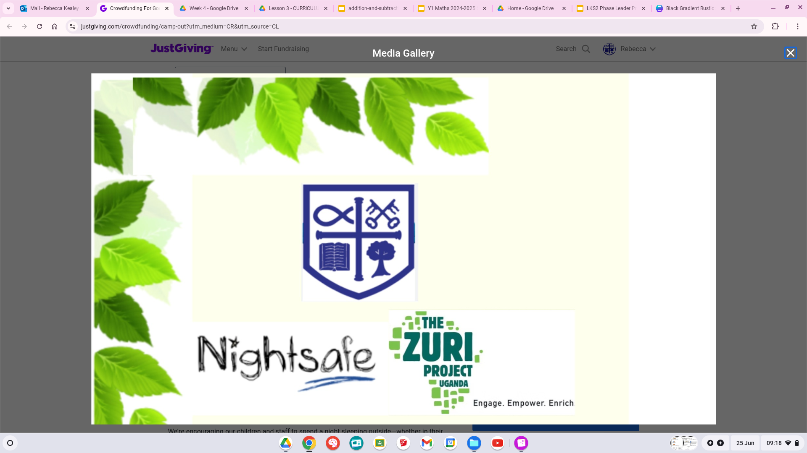

Slide 2

Language in Uganda
In Uganda, the most widely spoken language, especially in the capital city Kampala is English, which has been the country's official language since 1962, followed by Luganda.
Uganda is a multilingual country with over 70 estimated languages in active use. Of the 43 living languages documented,[4] 41 are indigenous and 2 are non-indigenous.
The children at Kishunju speak and learn in English at school but at home and in their community they speak their tribal language Richiga.

Slide 3
Some children might remember some of the key words we looked at last year so let’s see what you can remember.

Slide 4
agandhi
(a-gha-n-dee)
How are you?

Slide 5
njai
(nee-jai)
I’m fine

Slide 6
Webare
(wai-bar-ay)
Thank you

Slide 7
Webare munonga
(wai-bar-ay mun-on-ga)
Thank you very much

Slide 8
Twakushemererwa
(Twa- kush- ai-mair-ai-wa)
you are welcome

Slide 9
Nyambaho kacye
(Nay- amba- ho kay-cee)
excuse me

Slide 10
Eego
(yay-go)
yes

Slide 11
Nsasira
(n-sas- eera)
no

Slide 12
Osiibegye
(osibee-regai)
goodbye

Slide 13
Try a short greeting with the person next to you.
Person 1 - agandhi
Person 2 -njai webare
Person 1 -twakushemererwa
Person 2- agandhi
Person 1 -njai webare
Person 2 - twakushemererwa
Together - Osiibegye

