Slide 1
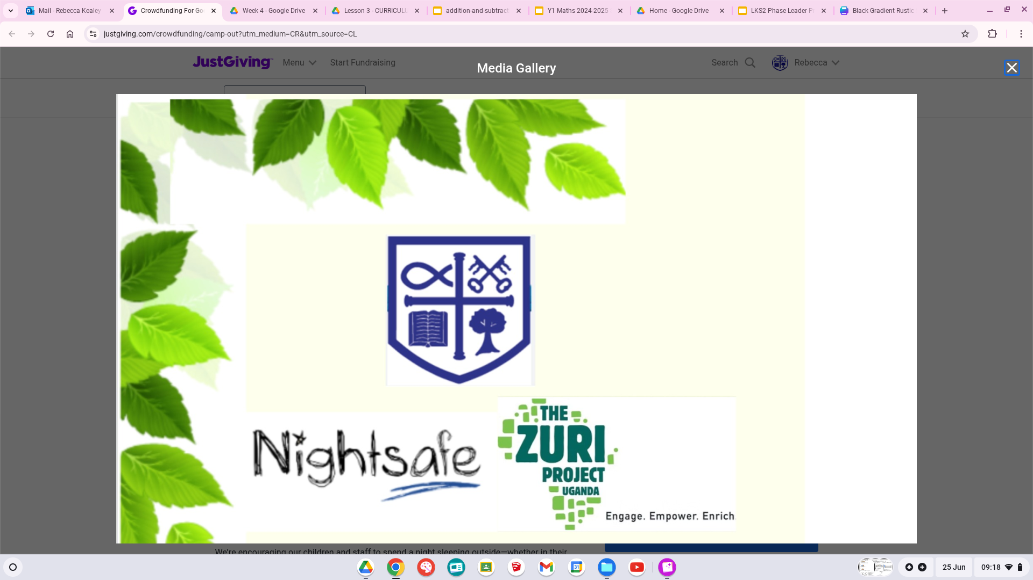

Slide 2
Kishunju Primary School would like to invite you to their morning worship.

Slide 3
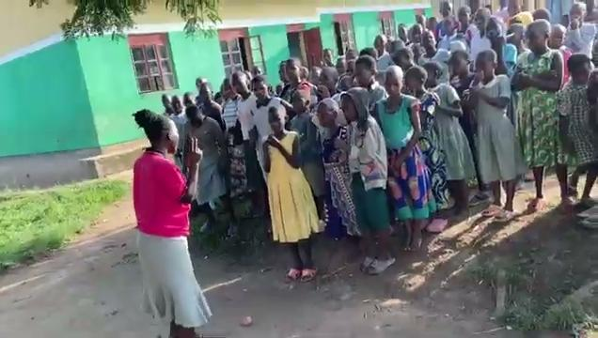

Slide 4
Thank you!
Kishunju Primary School want to say a BIG thank you for your amazing fundraising.

Slide 5
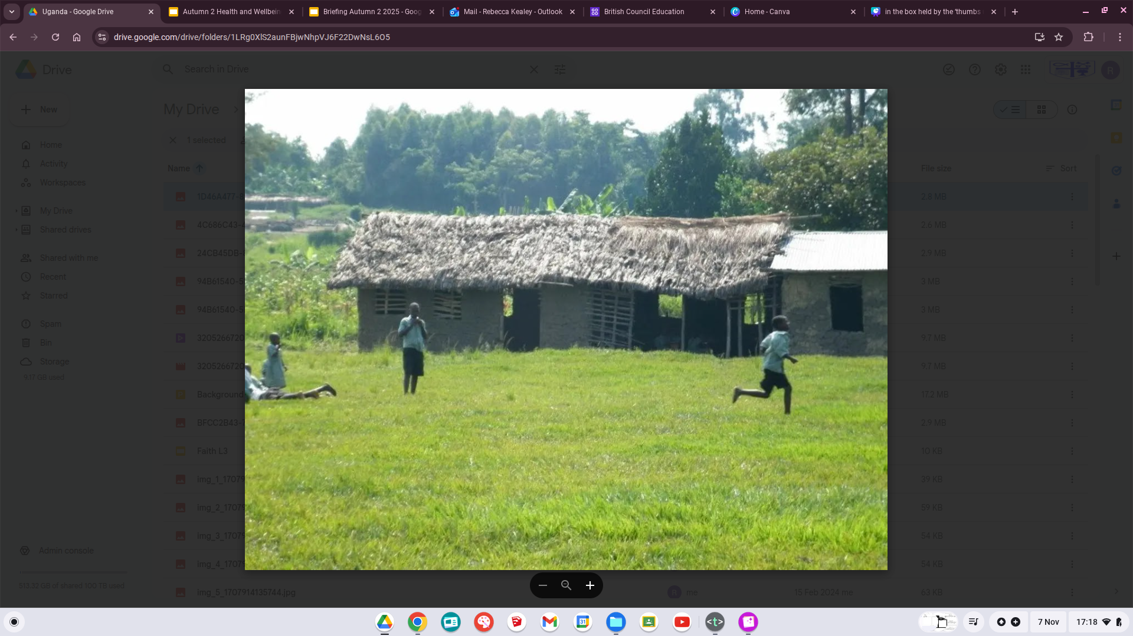
Before your help, their classrooms roof was collapsing and was being held up by mud, sand and wooden poles.

Slide 6
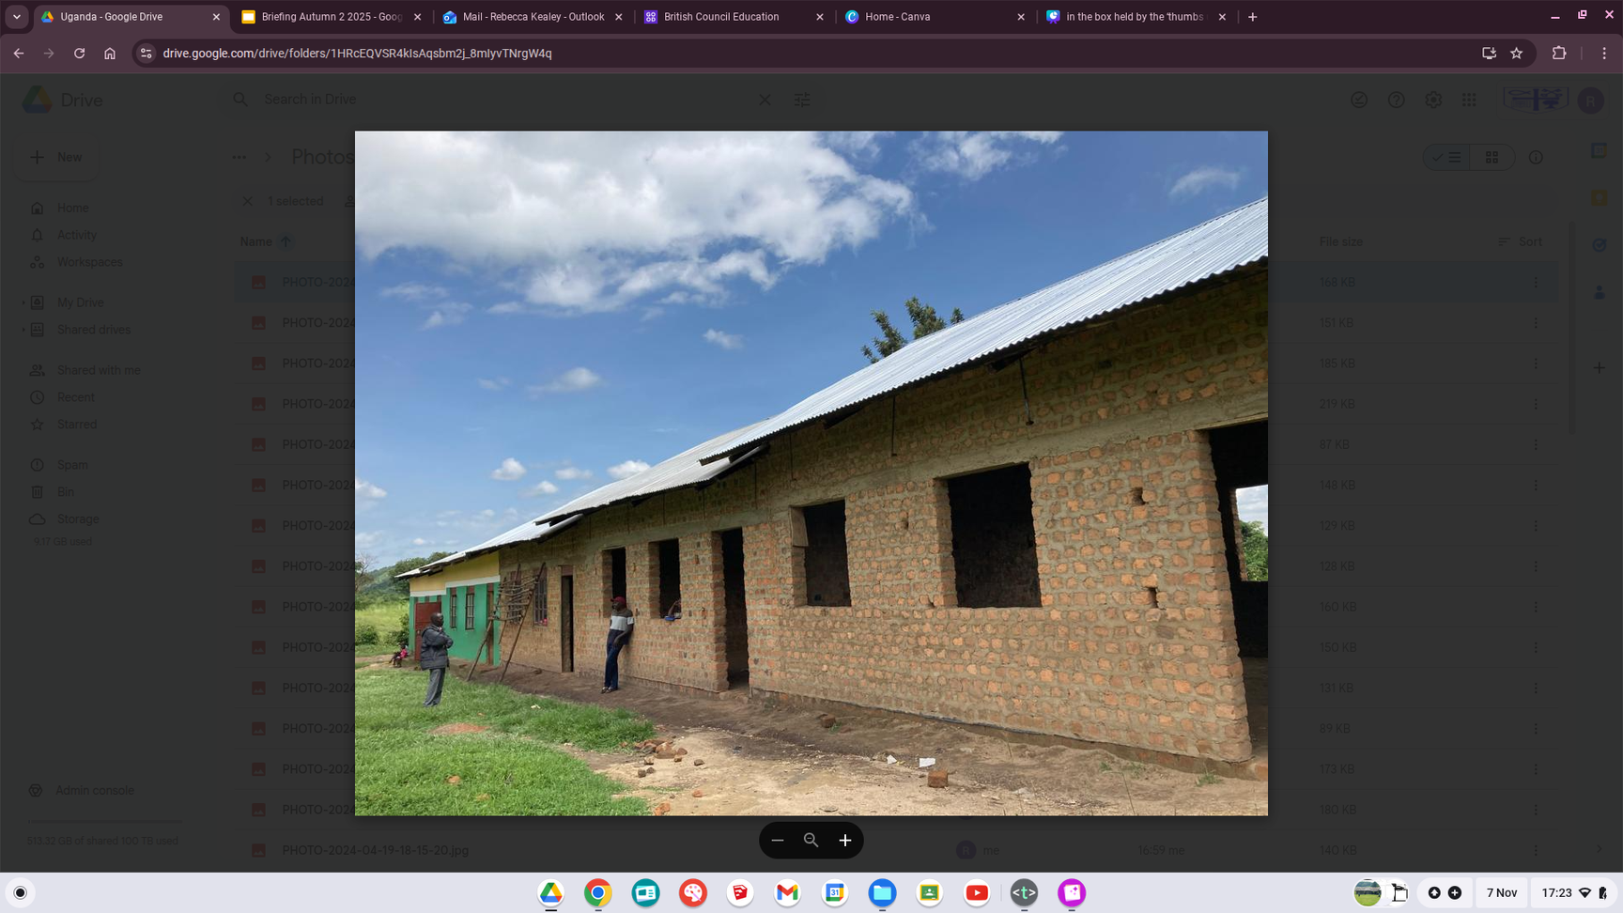
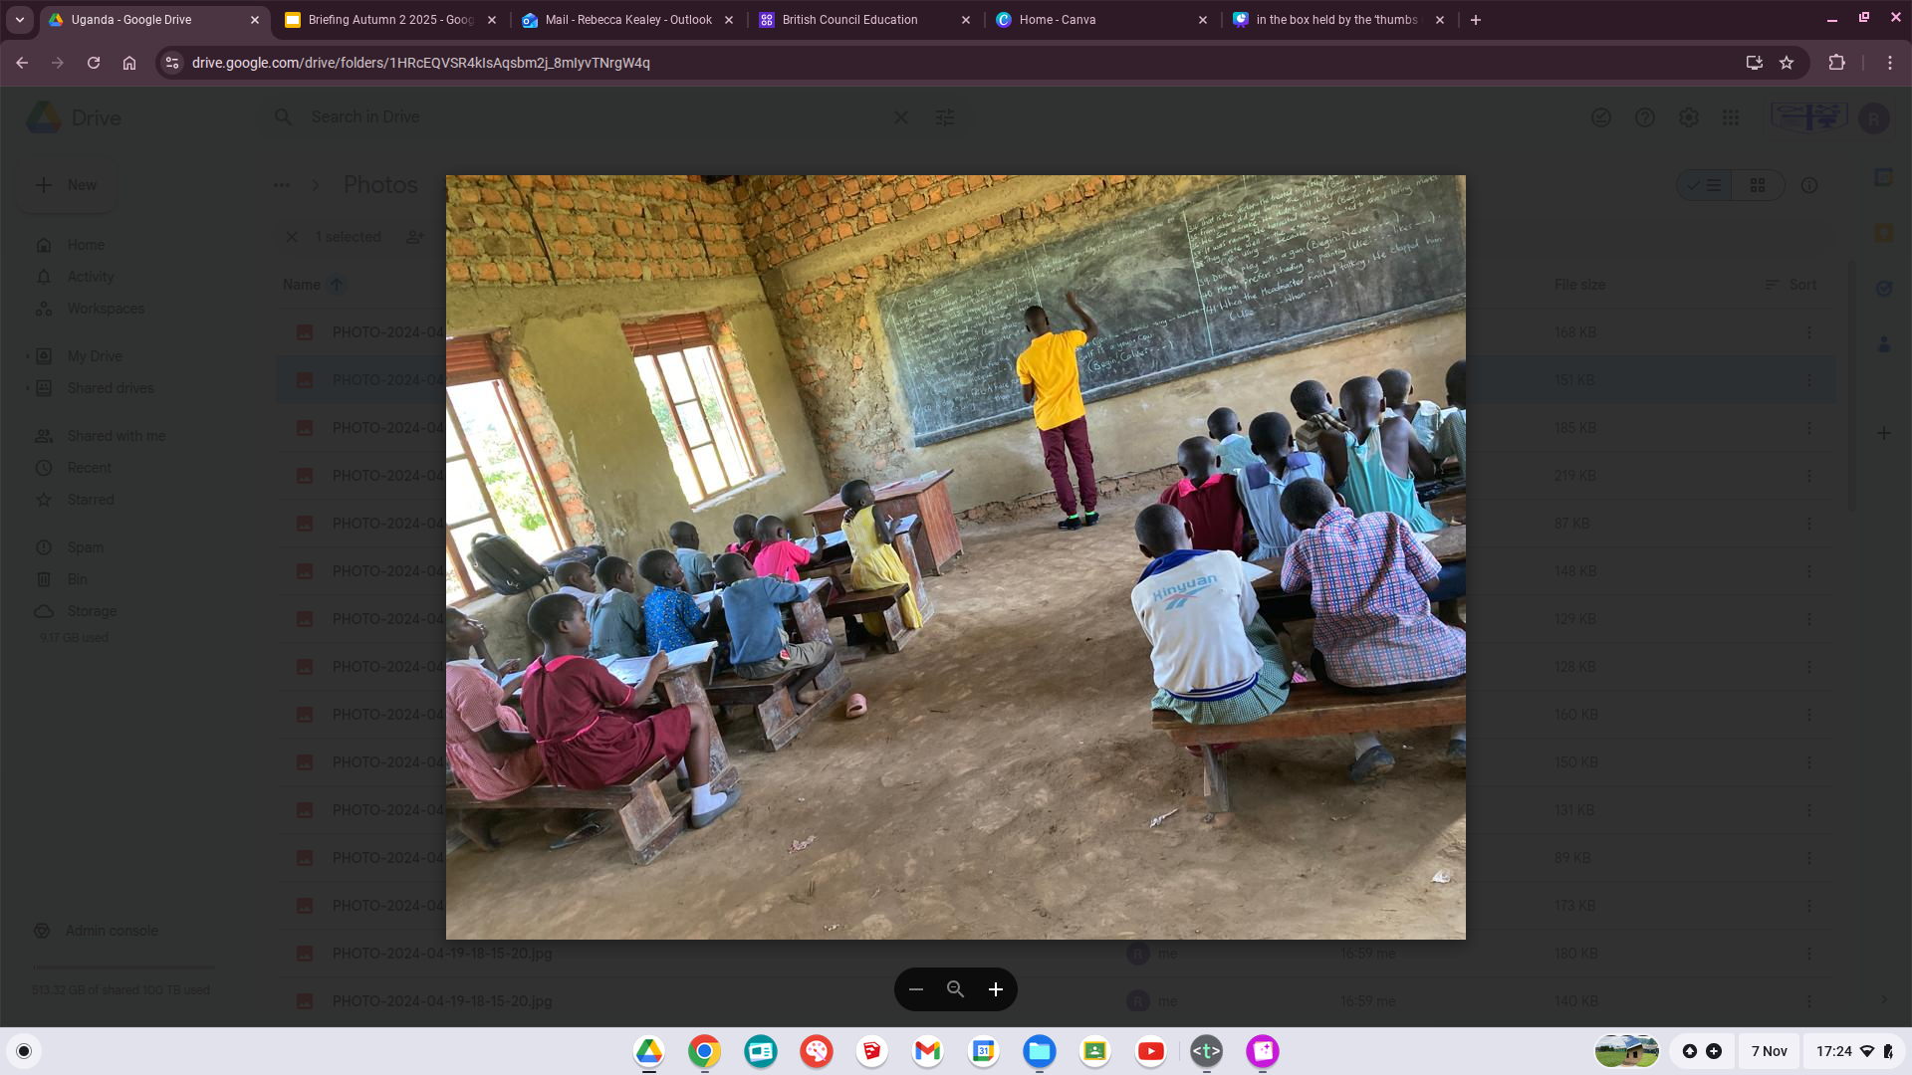
Now, thanks to you their classroom is bigger and better than ever.

Slide 7
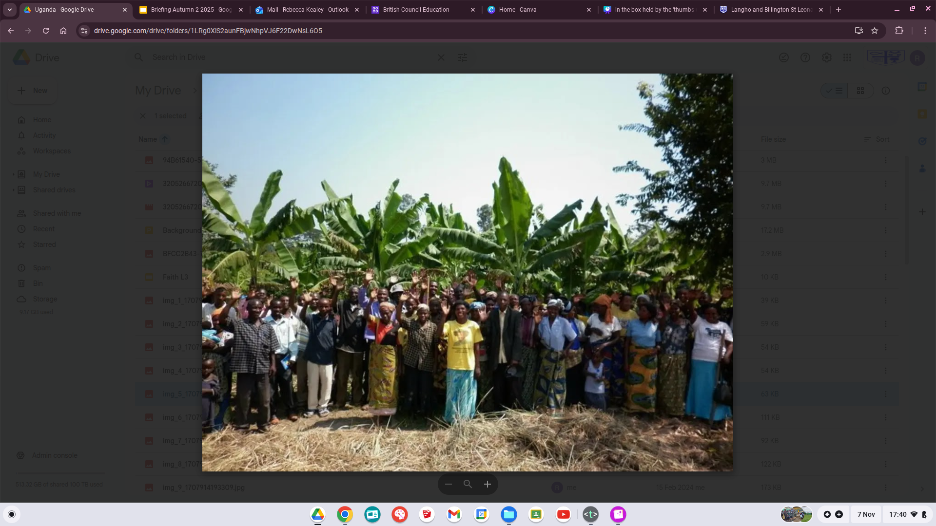
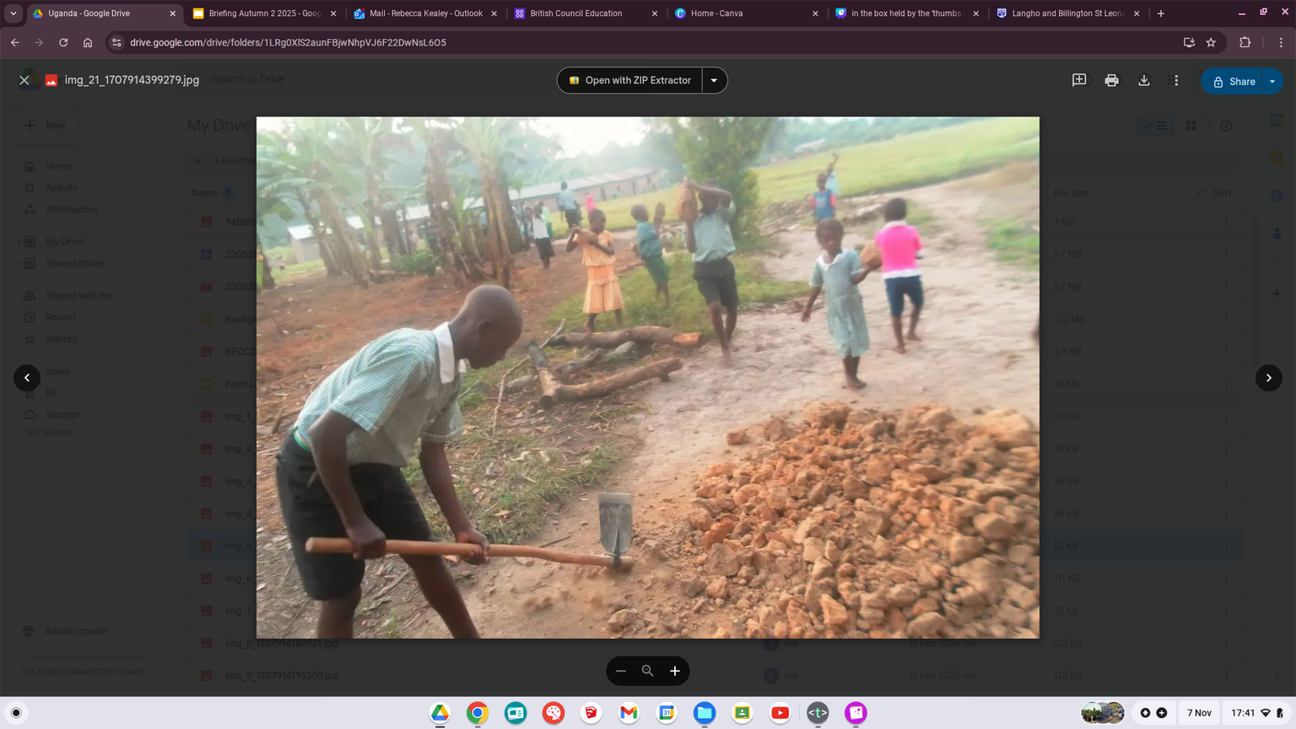
As a school and church community they worked together to build their classroom.
Even the younger children offered a helping hand.

Slide 8
Thank you St Leonard’s!

Slide 9
Class | Questions
Little Lennies
Blackbirds
Doves
Eagles
Falcons
Herons
Kingfishers | What subjects do you do? Who makes your school dinners and what do you have? We have Maths, times tables, English, spelling, Reading, Science, History, Geography, PE, agriculture, singing, dance, debate and crafts. The children in Year 6 make the school dinners for all of the children and teachers. We have matoke (mashed banana), beans, rice, unagi (flower and water) and vegetables.
Owls
Robins
Swifts
Wrens

