Slide 1
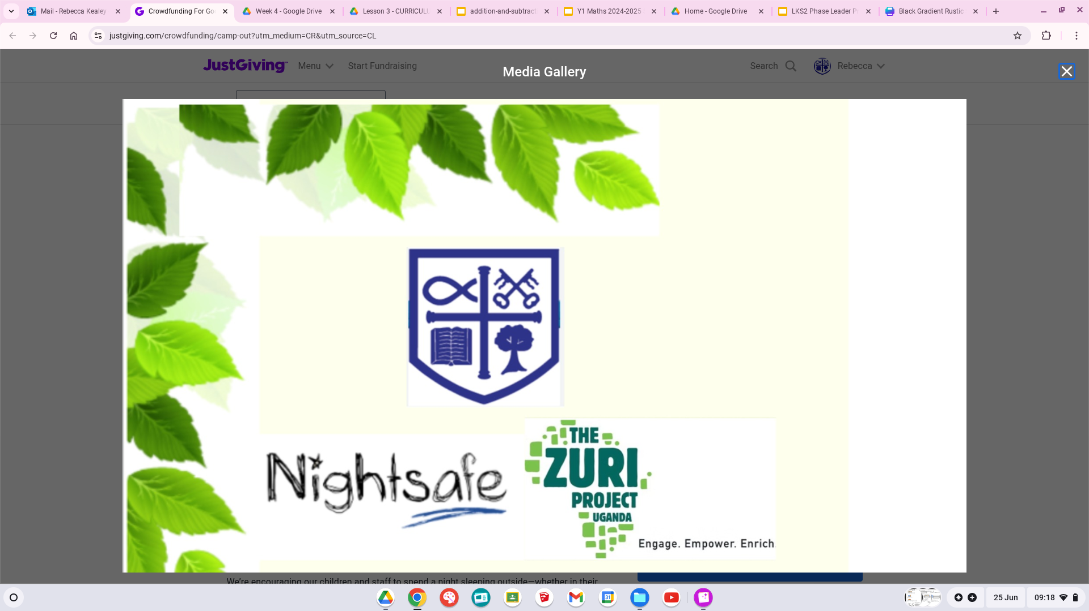

Slide 2

School in Uganda
A school year in Uganda starts in January and they have their summer holidays in December. They do this because of the warm weather and harvesting season. The church schools like Kishunju also do this because they only ever celebrate one person's birthday. Can you gues whos?
So that means the community at Kishunju Primary School never celebrate their own birthday. How would that make you feel?

Slide 3
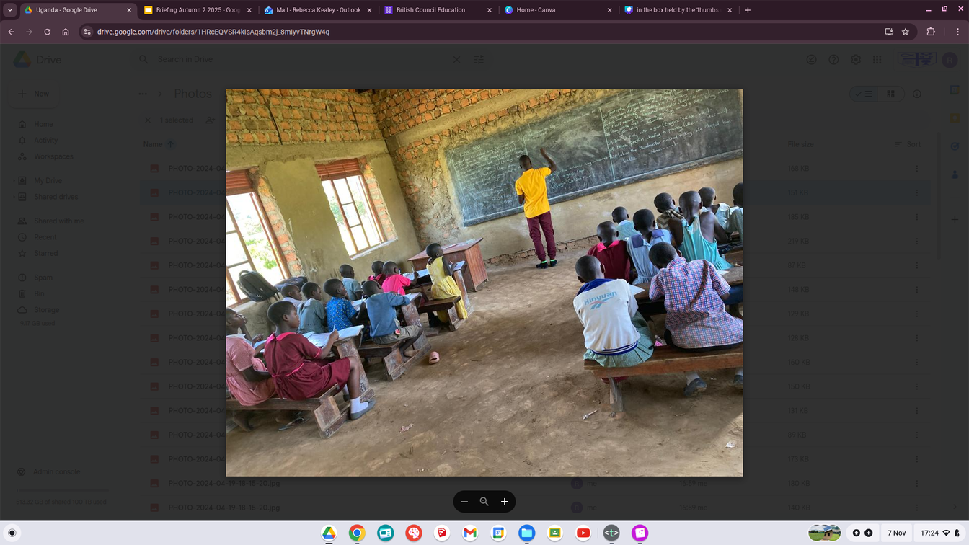
Classes in Uganda
In Uganda Children are put into classes not based on age like us but based on their ability. Therefore a child who is 6 could be in the Year 5 class and a child who is 14 could be in a Year 3 class.

Slide 4
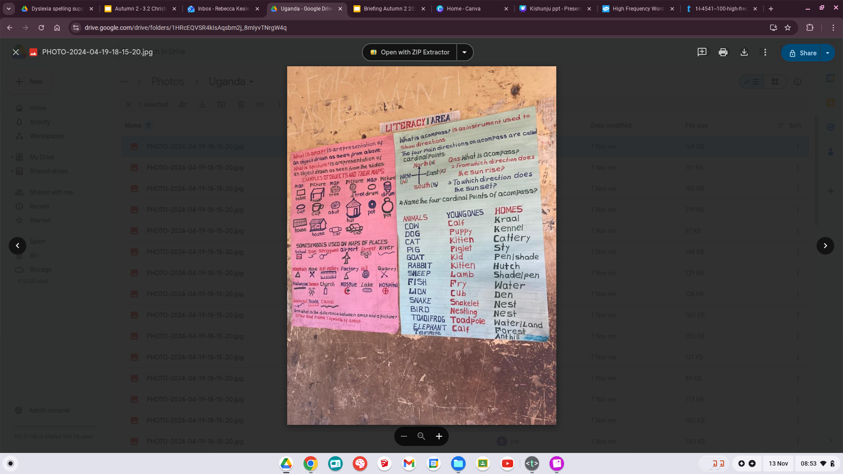
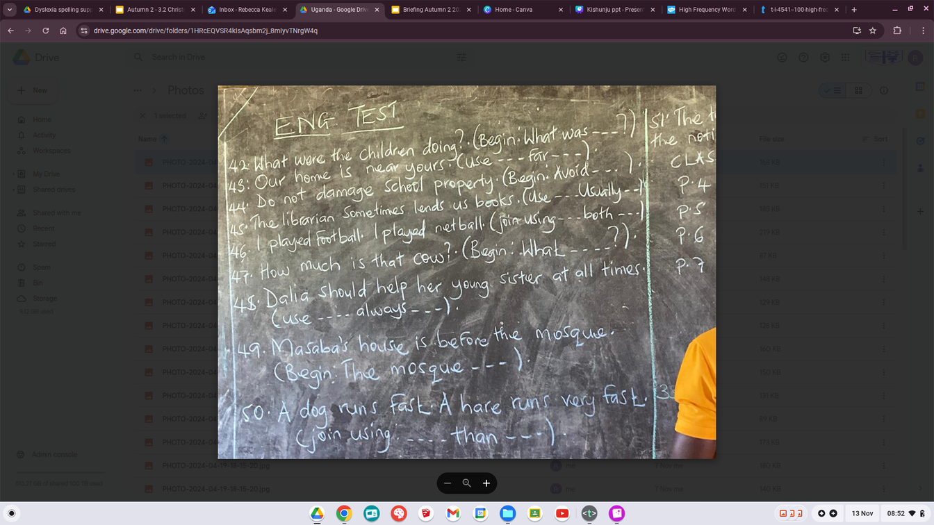
Assessments in Uganda
Similar to how we complete assessments the children at Kishunju do the same at the end of the year. However, they have to pass their assessment to move into the next year group. If they fail they have to redo the year again.

Slide 5
This week at Kishunju Primary School

Slide 6
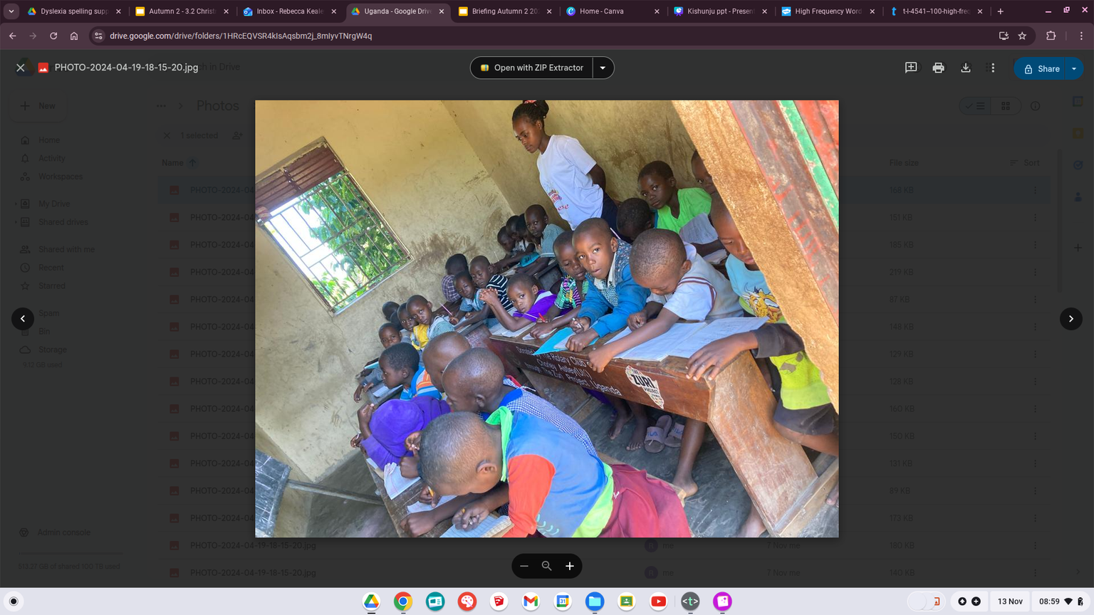
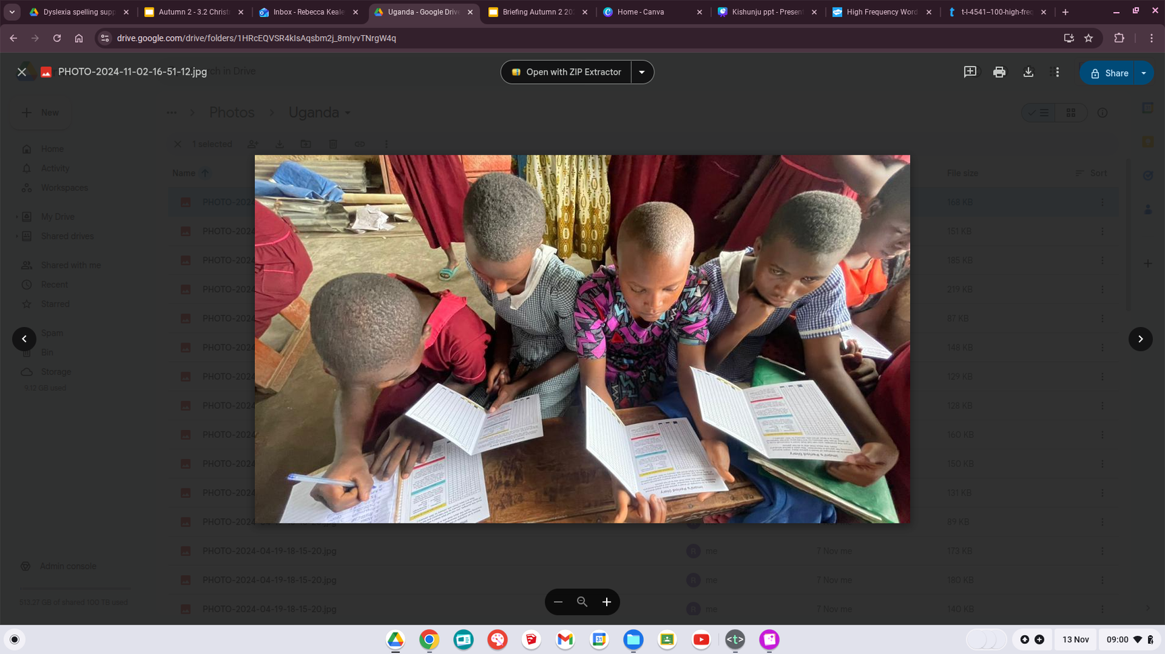
Assessments at Kishunju
All of the children, including those in Nursery have completed their assessments this week to see if they can move up into the next year group. P6 (Year 6) complete SATs just like we do here and so their assessments have been sent away to be marked. If the children pass then they need to complete another assessment to be accepted into their secondary school. If they fail, they redo the year.

