Slide 1



Robinwood Y6 Residential Trip
18th May - 20th May 2026
In Jesus' Footsteps, we grow in
grace and knowledge.

Slide 2
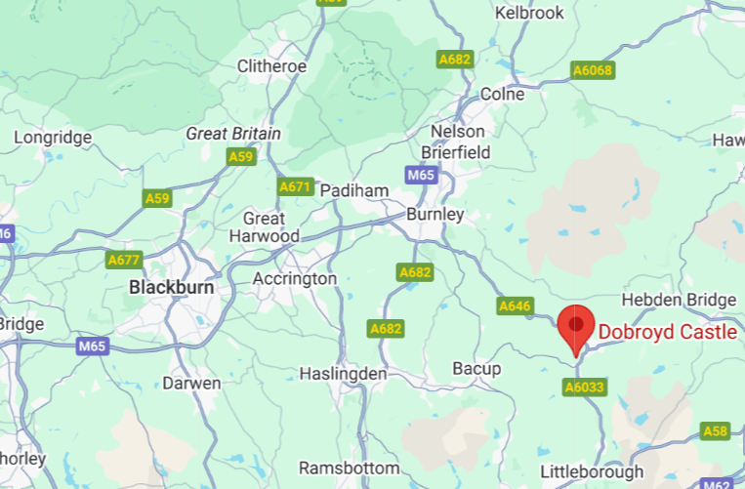

Location
Dobroyd Castle
Todmorden,
West Yorkshire
Approx 50 mins by coach.

Slide 3
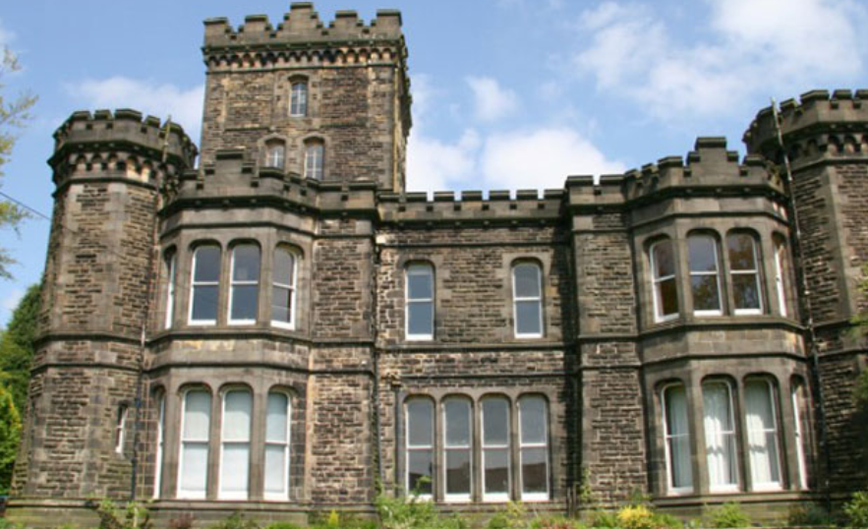
Accommodation
Main building or
three separate accommodation blocks

Slide 4
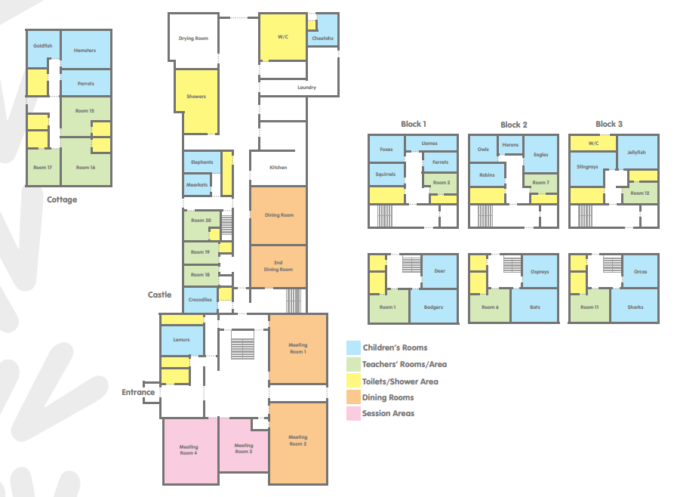
Children’s rooms will always be close to a teacher’s room.

Slide 5
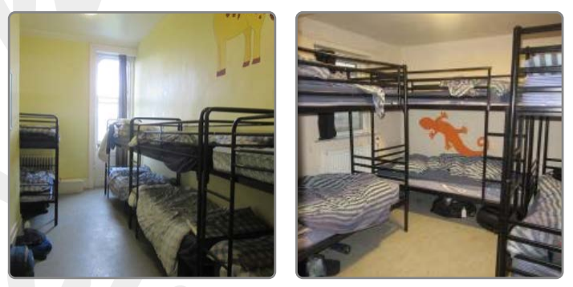
Example dormitories
Bedrooms all have bunk beds and range in size from 2 to 10 beds.

Slide 6
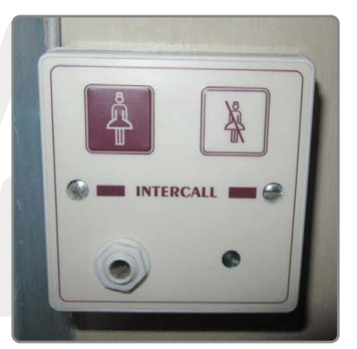
Call system
All dormitories have a call button if the children need help or reassurance during the night.

Slide 7

AT NIGHT..
SECURITY IS PARAMOUNT
There is always at least one male and one female member of Robinwood staff
awake and on duty during the night. Members of staff will be allocated rooms near to the children. The building is always secured overnight.
Emergency call button – in every room.
School staff also located on each dorm level - usually right next door - so be warned we don't want grumpy teachers due to lack of sleep !
Mrs Lindley will be contacted in the event of an emergency and will in turn contact parents.

Slide 8
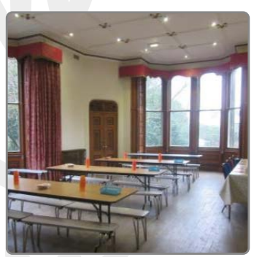
Catering
We will be given a set time for our meals and will eat together.
The children are very well catered for and there is no need to provide any extra snacks.
As well as toast and cereals a cooked breakfast is always provided.
Lunch typically comprises of wraps, sandwiches, fruits and yogurts.
Hot meals in the evening could be pasta bolognese, pizza or curry.
Break time snacks are provided and additional fruit is always available.
There is always a vegetarian option and dietary requirements such as gluten / dairy free, Halal or coeliac are catered for.

Slide 9
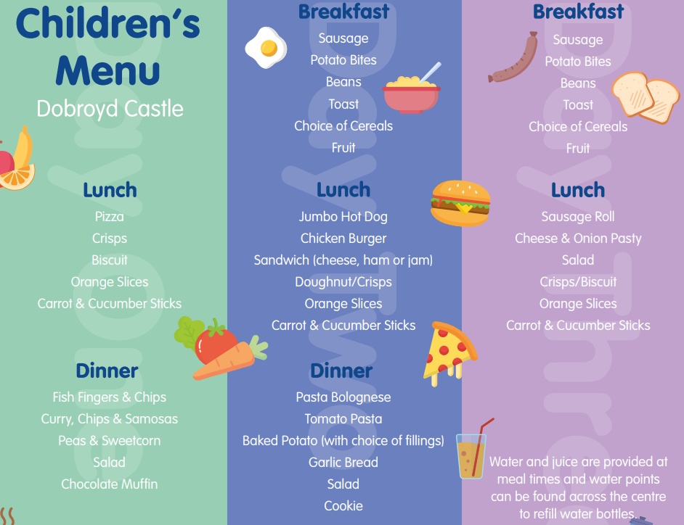

Slide 10
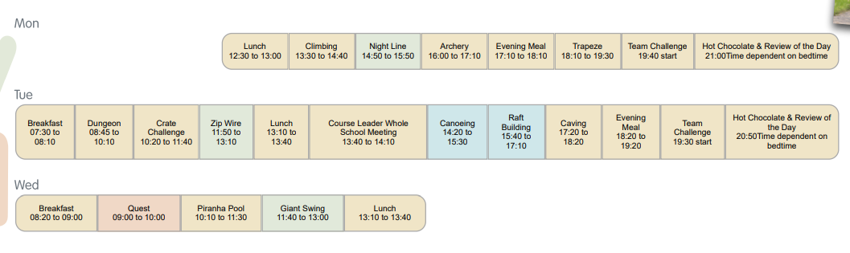
A typical itinerary

Slide 11
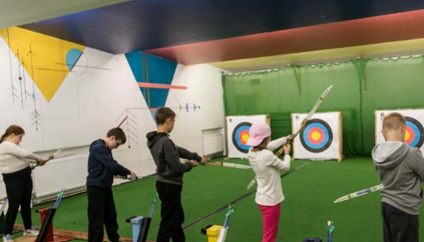
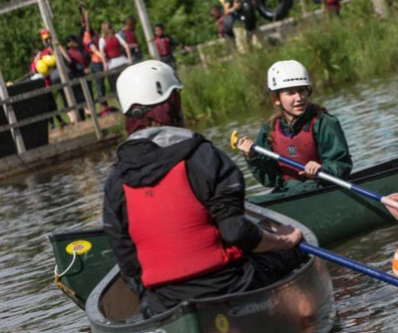
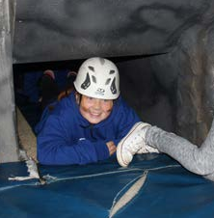
Activities
Archery
Canoeing
Caving

Slide 12
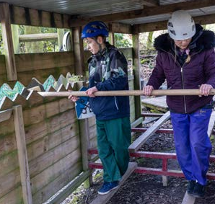
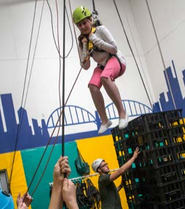
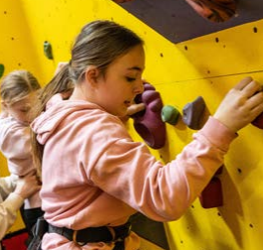
Activities
Challenge course
Climbing
Crate Challenge

Slide 13
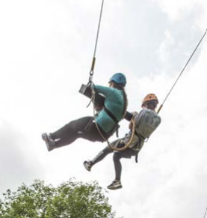
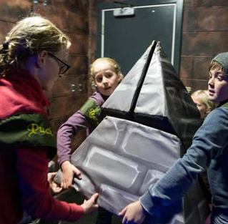
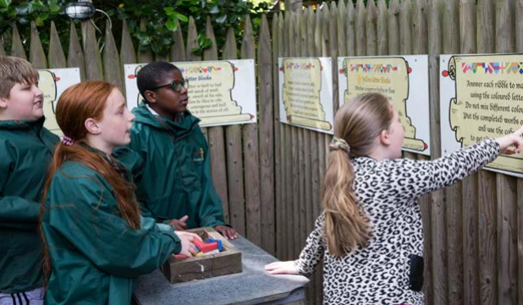
Activities
Escape the dungeon
Giant swing
Knight’s Quest

Slide 14
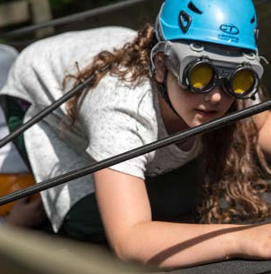
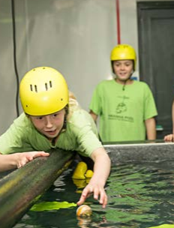
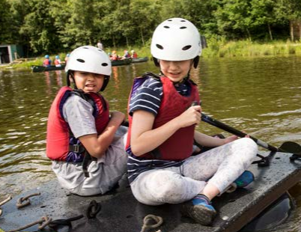
Activities
Nightline
Raft Building
Piranha Pool

Slide 15
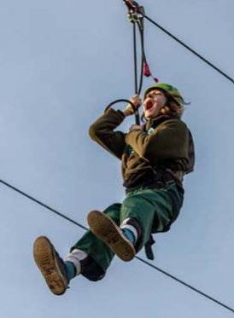
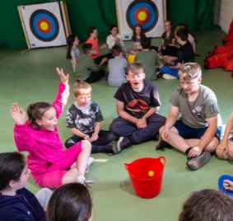
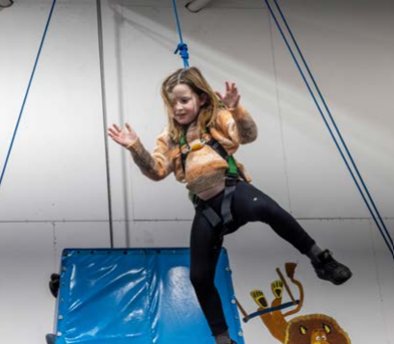
Activities
Zipwire
Team Challenge
Trapeze

Slide 16
Kit list
There is no need to go out and buy anything special for a trip to Robinwood, all specialist equipment is provided.
The clothing list given includes clothing being worn on the journey (so if you are wearing a pair of trousers for the journey, you only need to pack 2 more pairs).
Jeans are not suitable for the activities as they are restrictive and uncomfortable when wet – joggers and tracksuit bottoms are much better.
Everything MUST be clearly labelled.
Due to the nature of the activities, it is possible that clothes may occasionally get damaged. All clothing should be suitable for use in an outdoor, and sometimes muddy, environment.
Old clothes are best, not new or expensive clothing.

Slide 17
Kit list
• Refillable water bottle
• Comfortable long-sleeved tops (sweatshirts/jumpers/hoodies/fleeces)
• 3 T-shirts (no vests or crop tops)
• 3 Pairs of trousers (not restrictive; sportswear is good/ideally not jeans)
• 2 Pairs of shorts (knee length) or leggings you don’t mind getting wet
• 5 Sets of underwear
• 6 Pairs of socks
• 2 Pairs of trainers
• 2 Towels
• 1 Waterproof coat
• Sunhat and sun cream
• 1 Set of nightwear
• 1 Bag of toiletries
• 1 Bin liner (for wet clothes on day 3)

Slide 18
Any questions?
In Jesus' Footsteps, we grow in
grace and knowledge.

